Slide 1
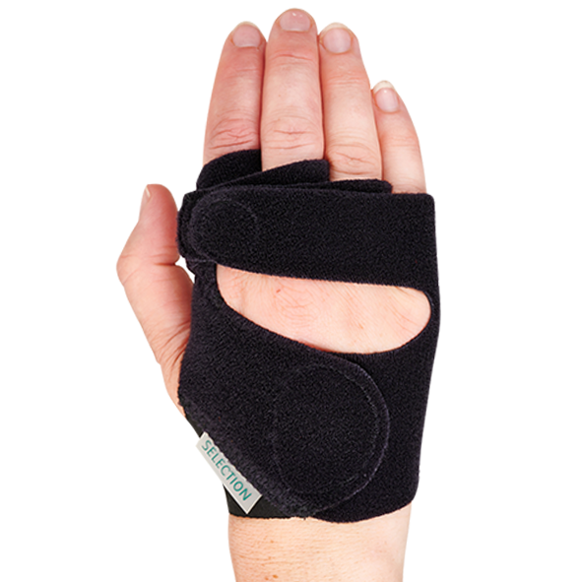
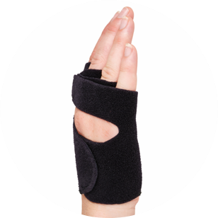
ULNAR DEVIATION ORTHOSIS
June 2022

Slide 2
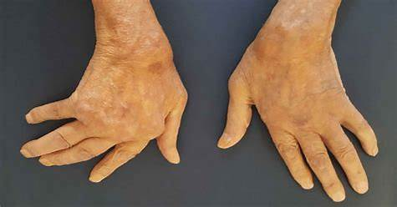
What is Ulnar Deviation – Ulnar Drift
Hand deformity in which the fingers are displaced, tending towards the little finger
The swelling of the metacarpophalangeal joints (MCP) causes two problems:
Ulnar deviation and volar subluxation.
Ulnar deviation occurs when synovitis (inflammation of the synovial membrane that cushions the joints) has caused problems in the ligaments or muscles in the wrist and hand.
When ligaments have become weakened, the flexor tendon connecting the forearm muscles to the thumb and finger bones can become dislocated and shift toward the palm and the ulna.
Healthjade.net

Slide 3
What is Ulnar Deviation – Ulnar Drift
Most common medical conditions that can cause ulnar deviation:
Rheumatoid arthritis
Lupus
Osteoarthritis
Symptoms:
Swelling, warmth, or pain in the wrist, hand, and finger joints
Pain or tenderness around your wrist, hand, and finger joints, especially when you move or flex your fingers
Limited range of motion of the fingers. Inability to fully flex your fingers or make a fist
Reduced grip strength
Inability to pick up objects or do certain tasks with your index finger and thumb, such as using zippers or squeezing objects

Slide 4
TREATMENT
Treat the underlying condition.
Anti-inflammatory medications can control chronic inflammation and help reduce swelling and pain in the hand.
Splints and hand braces can keep the fingers in place while adding extra support to the wrist.
Surgical procedures. Fix the damaged ligaments. Ligament transplant or tendon transfers.
Therapy. Wrist and hand exercises may increase muscle strength and improve range of motion.

Slide 5
SELECTION® ULNARDEVIATIONSORTOSIS
Low profile design
Meets the shape and contours of the hand
Material extends far to the ulnar side at 5. MCP to support the best possible direction of pull
Breathable fabric. Unique Three-layer Selection fabric
Fabric can be trimmed without fraying
Easy fastening - the hook can be placed anywhere on the splint to optimize the directional pull needed
Can be worn with Selection Wrist Splint
Machine washable

Slide 6
SELECTION® ULNARDEVIATIONSORTOSIS
Size XS-XL
Left/Right
Sizing: Circumference MCP 2-5

Slide 7
Instructional Video:
https://www.allardint.com/products/wrist-and-thumb/wrist/selection-ulnar-deviation-splint-p45277

Slide 8
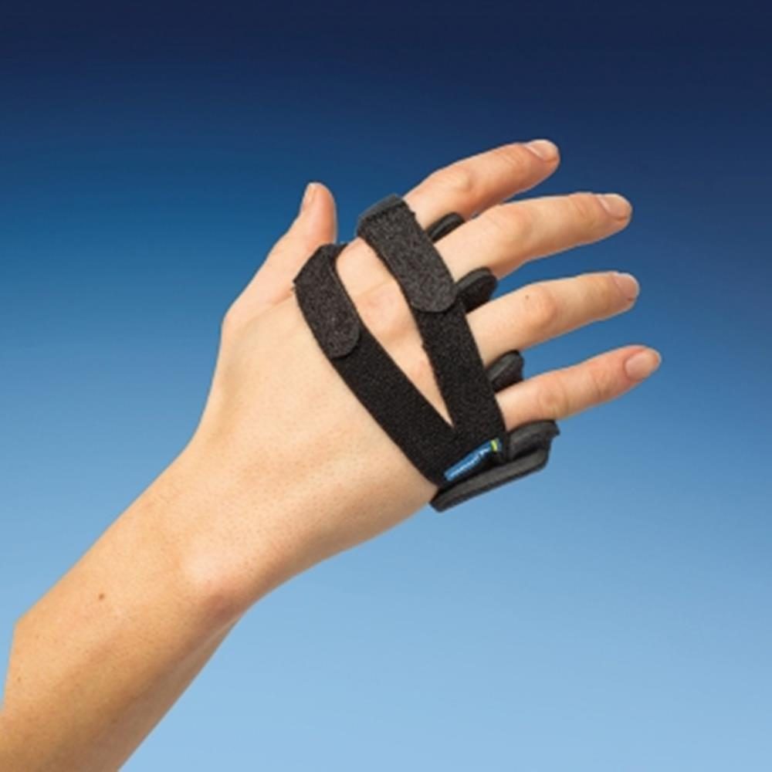
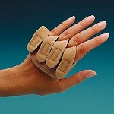
COMPETITOR – OTHER DESIGNS
MediRoyal
Metal core – hard
No support for palm
Performance Health
Bulky

