Slide 1
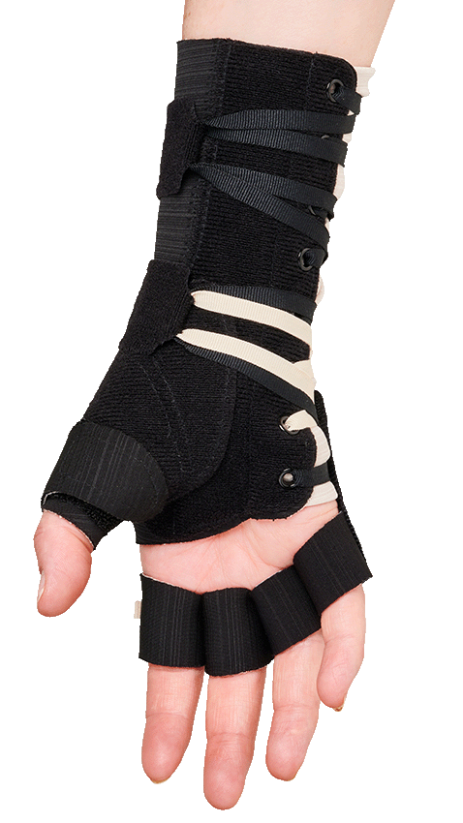
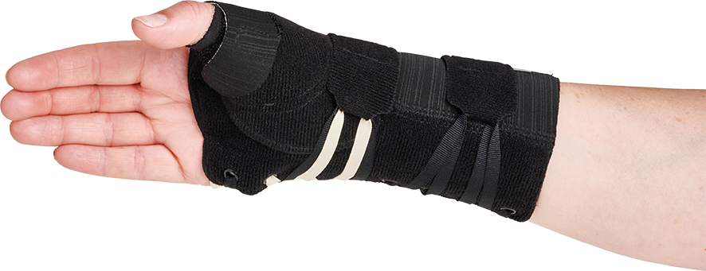
ALLARD SELECTION Multi Open & Radialis

Slide 2
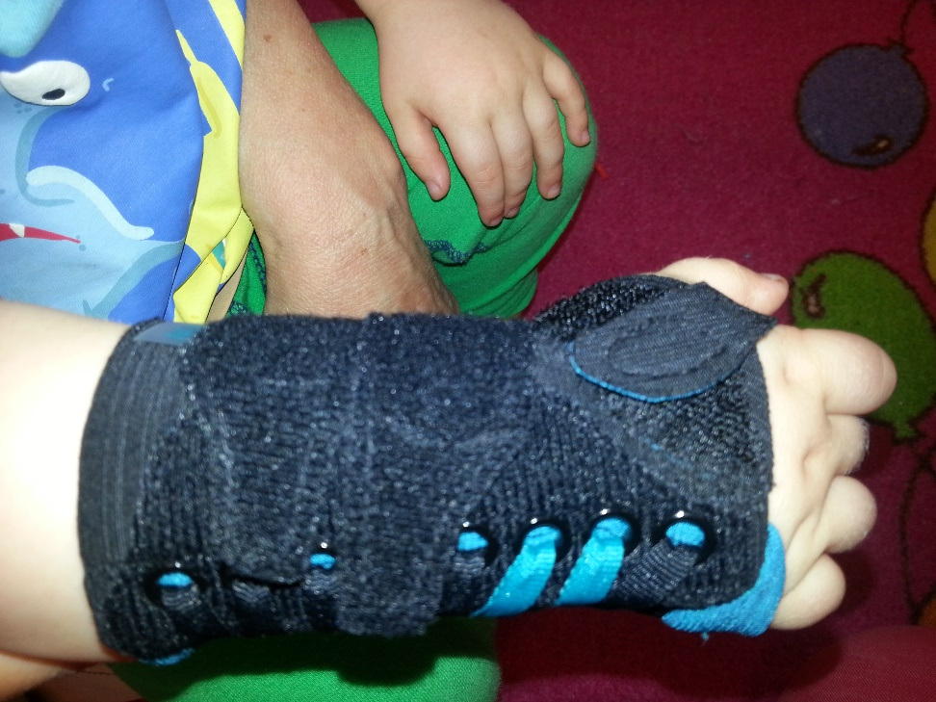
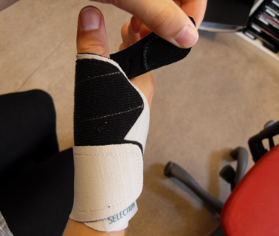
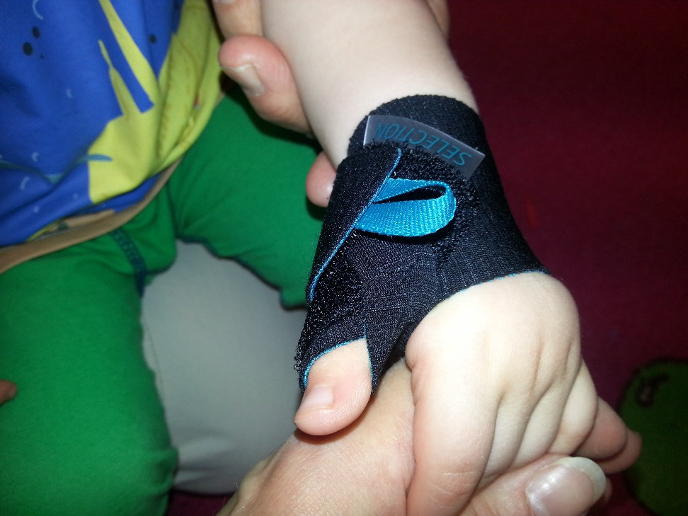
SELECTION RANGE!

Slide 3
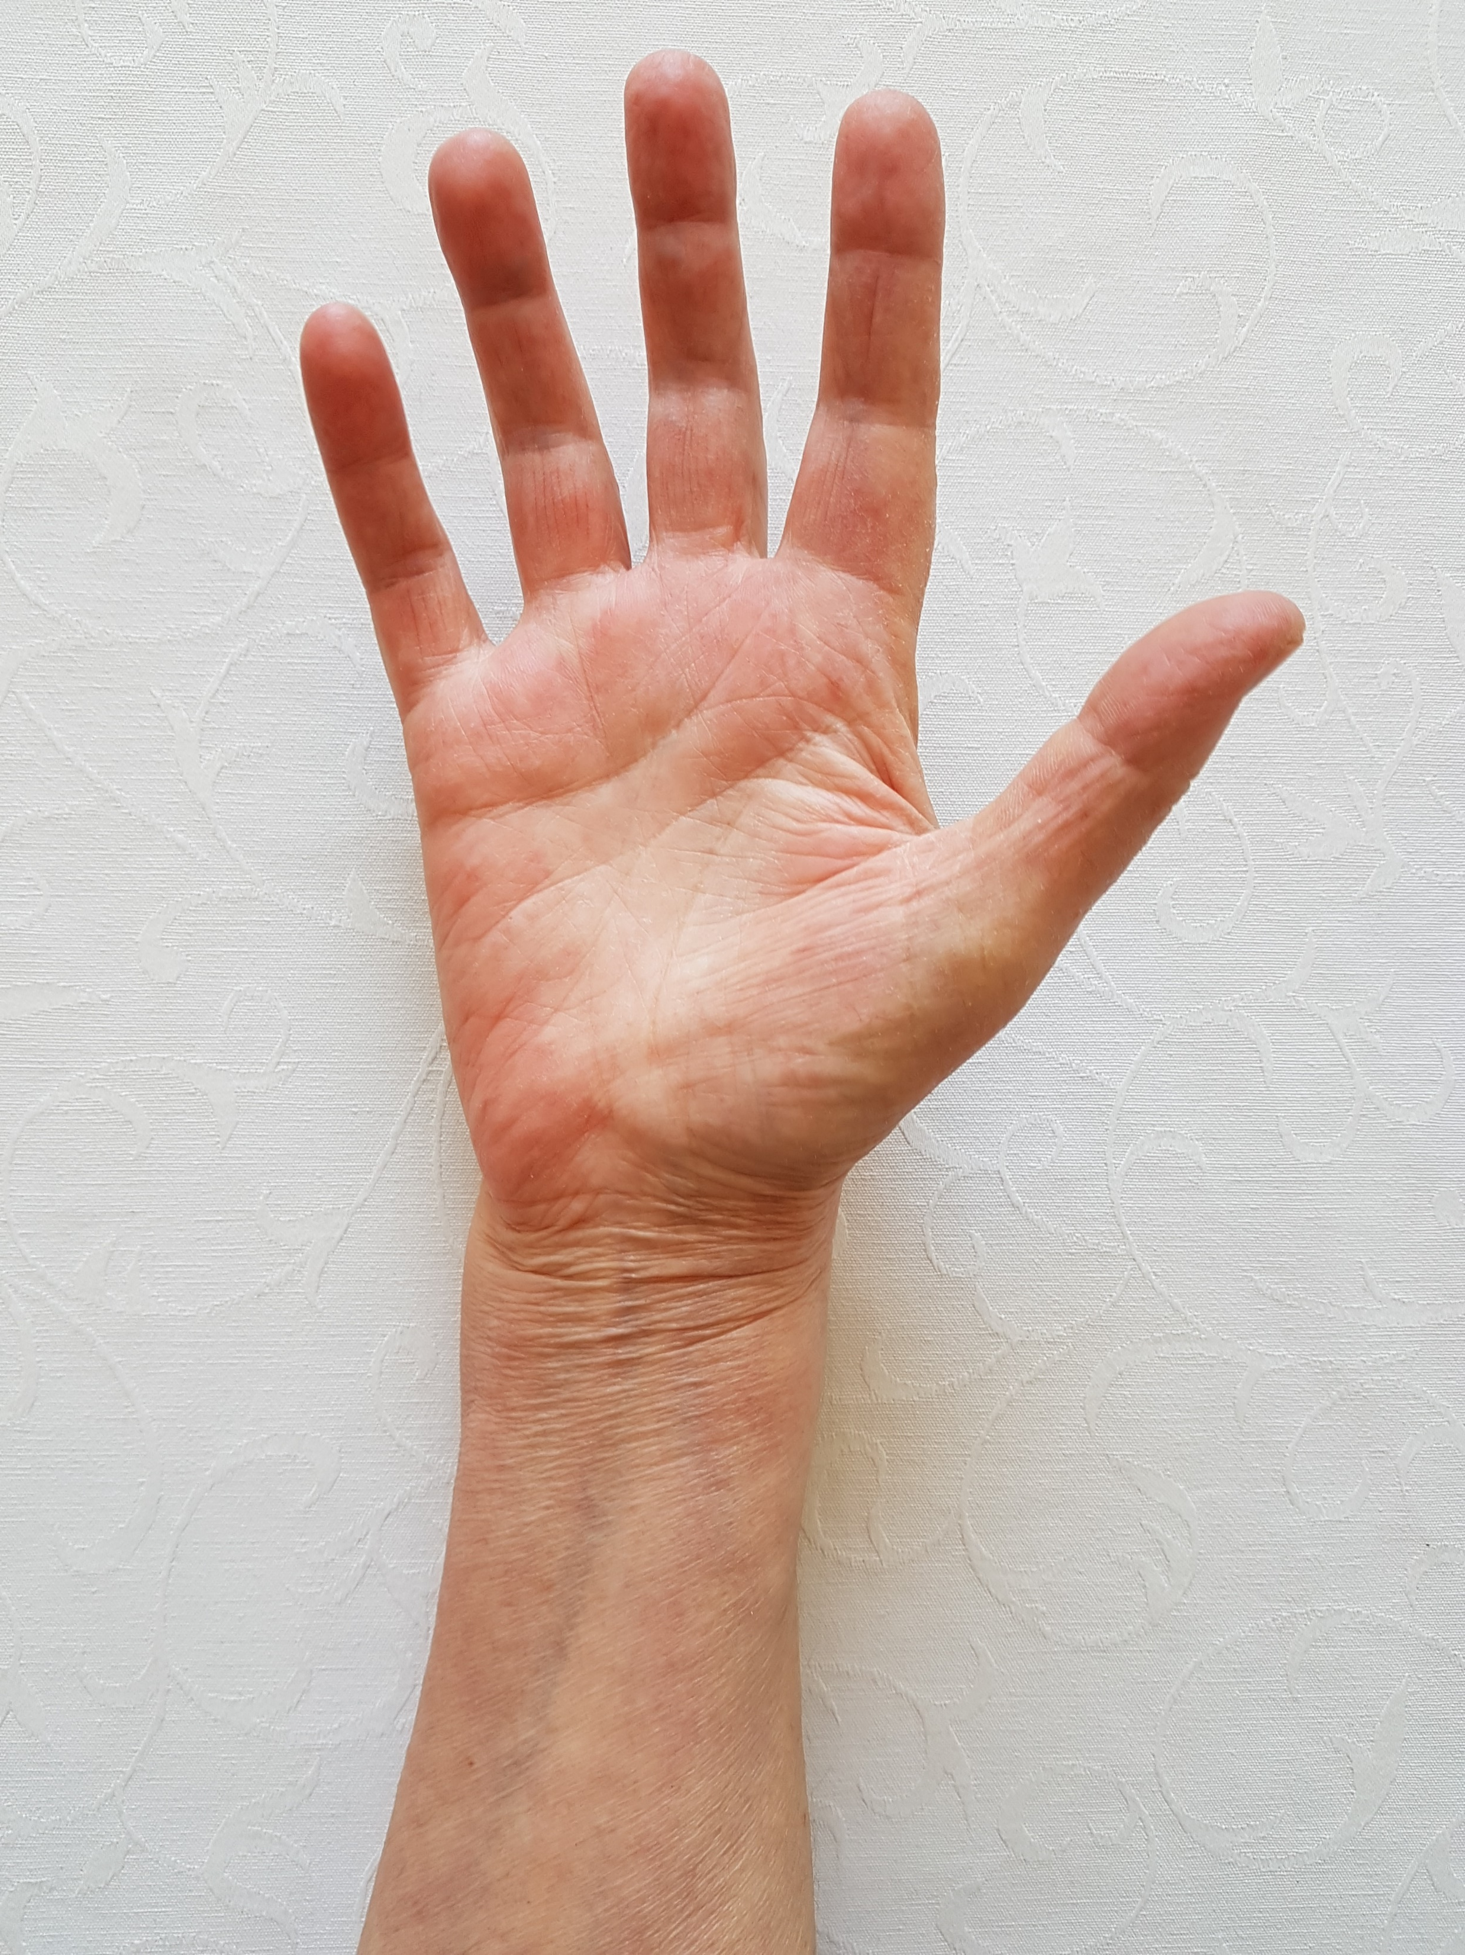
TIPS
Plastic vers. Metal Stay
Plast slightly flexible not as strong but accumulates the energy for a dynamic support
Wrist support step one: Close Wrist strap
Wrist: Stay paralle with 3. & 4. finger
Stay below MCP joints volar
Tip: All demos same hand eg. right

Slide 4
FEATURES SELECTION
Two elastic materials with a ridig core material – No glue
Triumf Underwear material against the skin
Breathable and low profile
Modern version with lace closure system
Smooth outer – Sliding on the clothes
No edging material allows a customized fit – cutting edges
Plus model = wider proximal/NEW Multi Open
OTHER?

Slide 5
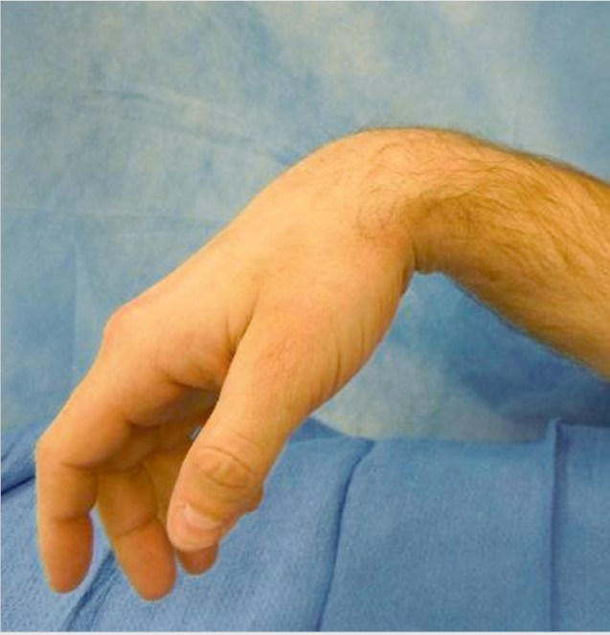
What is Radial Nerve Palsy?
Compression of the radial nerve
Pain, weakness, or loss of function in wrist, hand, and fingers
Inability to control the muscles inhibited by the nerve
REASONS:
Fractures or dislocations
Bruises that put pressure on the radial nerve
Growths such as tumors or cysts
Pressure injuries caused by awkward body positions for long periods of time, such as while working or sleeping
Infection or inflammation

Slide 6
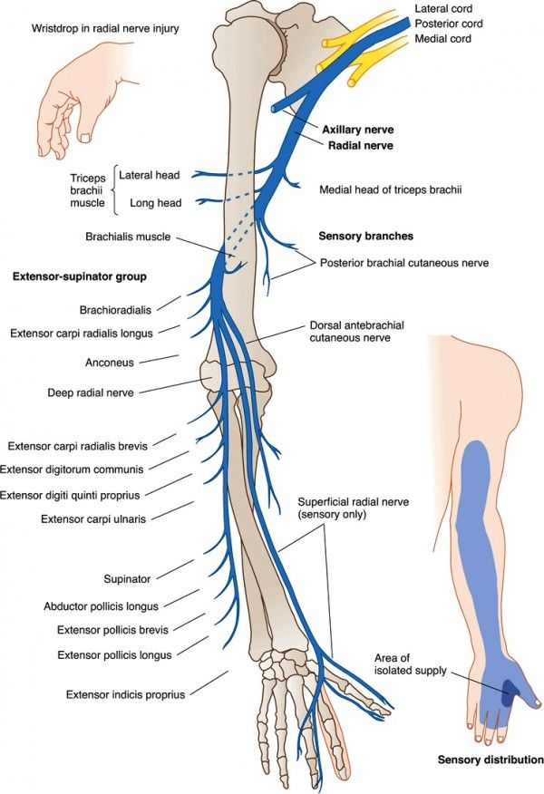
Muscles that are affected?
Upper arm:
Triceps
Braciradialis
Extensor carpi radialis longus
Forearm:
Extensor carpi radialis brevis
Extensor digitorium
Extensor digiti quinti proprius
Extensor carpi ulnais
Extensor policis brevi
Extensor policis longus
Extensor indicis proprius
Numbness from the triceps down to the fingers
Problems extending the wrist or fingers
Pinching and grasping problems
Weakness or inability to control muscles from the triceps down to the fingers
Wrist drop – when the wrist hangs limply, and the patient cannot lift it

Slide 7
TREATMENT & RECOVERY
Medication:
Prescription or over-the-counter medication to decrease pain associated with radial nerve palsy.
Physical Therapy
Exercises to strengthen your muscles and increase your range of motion.
Splint or Cast
A splint or cast can support the wrist and hand while the radial nerve heals.
Surgery
In certain cases, surgery to remove a cyst, tumor or broken bone pressing on the nerve or repair the nerve itself.
Transcutaneous Electrical Nerve Stimulation (TENS)
Gentle electric stimulation to the muscles, may also help reduce pain.
Recovery
Recovery time depends on how badly the radial nerve is damaged. It may take weeks to months for a nerve to heal after treatment.

Slide 8
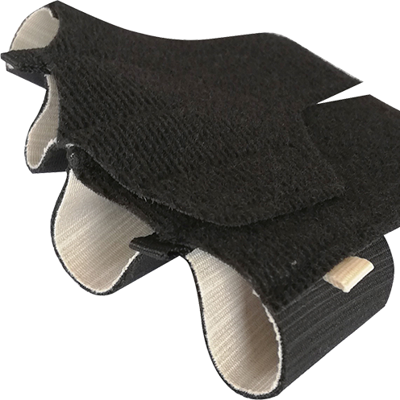
Our Contribution in Conservative Treament
Selection Radialis Finger and Thumb part
Combine with SELECTION® Wrist orthosis model numbers 35204, 35205 and 35209.
Why seperate parts:
Positioning
Parts affected

Slide 9
MCP.4-5 Better positioning with the separate finger part!

Slide 10
SELECTION RADIALIS FINGER Art:35217
Size:
Right/Left
S-M-L
Obs Beige indicator = 1. part

Slide 11
SELECTION RADIALIS THUMB Art:35216
Size:
Right/Left
S-L
Compatible with all Selection models

Slide 12
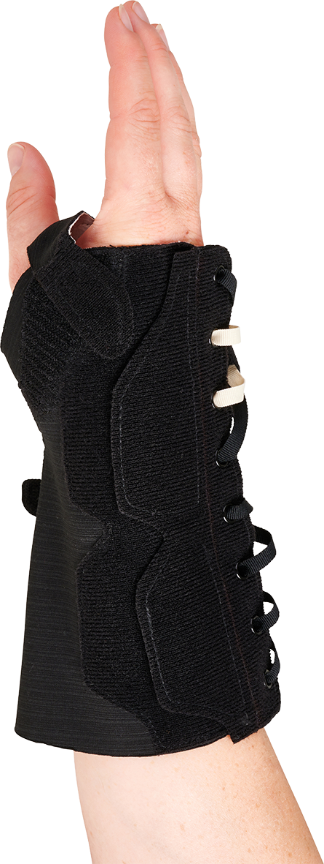
SELECTION MULTI OPEN ART. No 35209
2 in one
Open model or regular lace closure
Long model - 2/3 forearm (4 cm)
Metal Stay
Wide forearm, swollen wrist
RIGHT/LEFT
XS-XXL

